Slide 1
Implicit Parameter
Instance methods and Class methods

Slide 2
Example: translate method of Rectangle
rect1.translate(100, 80);
moves the rectangle 100 units (pixels) to the right and 80 units (pixels) downward
Rectangle rect1 = new Rectangle(70,90,100,150);
rect1.translate(100, 80);
moves the rectangle to be a rectangle with the data (170, 170, 100, 150)
Instance methods are those that have to be called on an object (the other methods are static methods, also called class methods, e.g Math.max)

Slide 3
Getting to the issue of implicit parameter
public static void main(String[ ] args) {
Rectangle rect1 = new Rectangle(70,90,100,150);
Rectangle rect2 = new Rectangle(70,180,200,50);
rect1.translate(100, 80);
}
There is only one copy of the code for the method translate, not one copy for each object
How is that translate moves rect1 and not rect2 ?
The code of translate has to receive a reference to the object it will read information from or modify
Compile and run the code of FirstGUI.java

Slide 4
The reference is passed as if it were a parameter
The activation record of a method contains various parts starting with the space designated for the parameters, where the arguments are stored
For instance methods, the reference to the object is also stored in the activation record as if it were a parameter.
It is called the implicit parameter (Section 3.7)

Slide 5
Putting the implicit parameter into the stack
The rect1.translate(dx, dy) call causes the values of
rect1
dx
dy
to be put into the activation record in the call stack.
The implicit parameter carries the name “this”
The code executed is then
rect1.x = rect1.x + dx;
rect1.y = rect1.y + dy;

Slide 6
The presence of this is understood
The code of the translate method can be written as
x = x + dx;
y = y + dy;
or
this.x = this.x + dx;
this.y = this.y + dy;
They are synonymous for the compiler. Hence if the current value of “this” is the reference “rect1” then the code executed is indeed
rect1.x = rect1.x + dx;
rect1.y = rect1.y + dy;

Slide 7
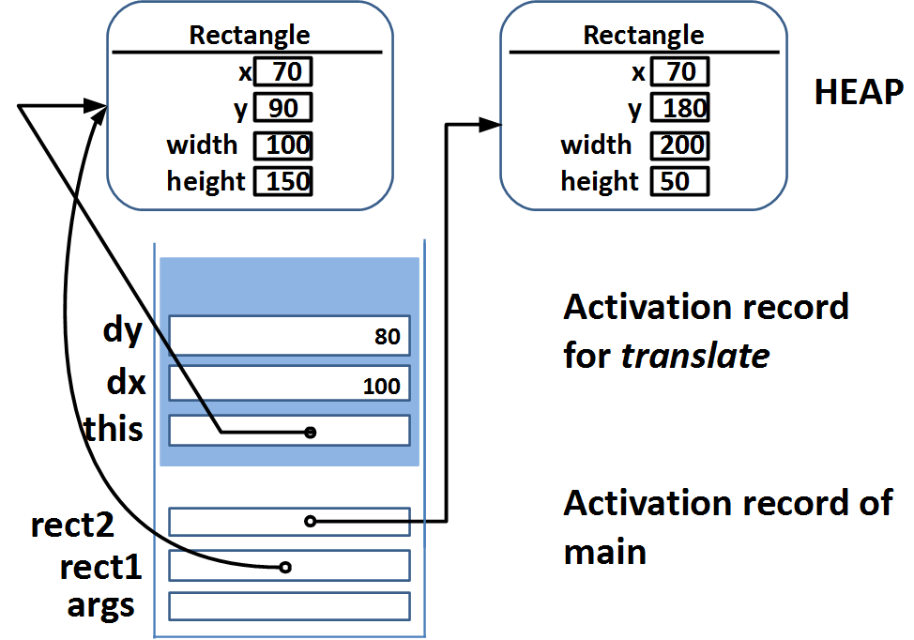
Activation record for translate(dx, dy)

Slide 8
Instance vs class methods
If the method needs to read or modify the instance fields (i.e. fields that are not declared as static), then the code needs access to the reference “this” which we call the implicit parameter
If the method is more stand-alone as was the case with the methods we saw for arrays, then they can be declared as static. These are also called class methods and they do not have the implicit parameter in their activation records

